Slide 1

The 2018 CSUN Annual Digital Accessibility Legal Update
#CSUNATC18
Lainey Feingold
@LFLegal**LFLegal.com

Slide 2
Fine Print
LFLegal.com Legal Updates
are Not Legal Advice

Slide 3
Remembering Our Place
Luiseño
Buseño
Cahuilla
Diequeño

Slide 4

Goals of This Session
Make sense of the legal landscape
Help shift from fear to motivation
You have a role: how can the law help?
Make sense of what happens tomorrow

Slide 5
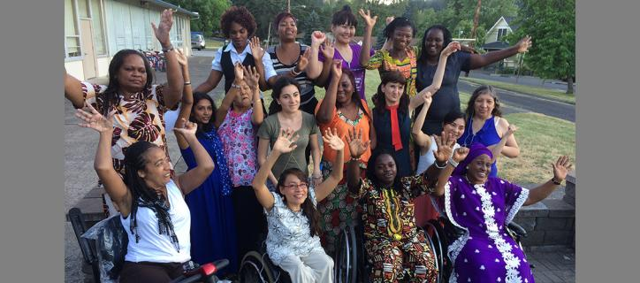
Accessibility is about . . .
photo: MIUSA

Slide 6
Who are these People?

Slide 7
People (users!)
Students
Shoppers
Patients
Customers
Tax payers
Investors
Employees and applicants
Sports fans
Citizens
Diners
Home owners

Slide 8
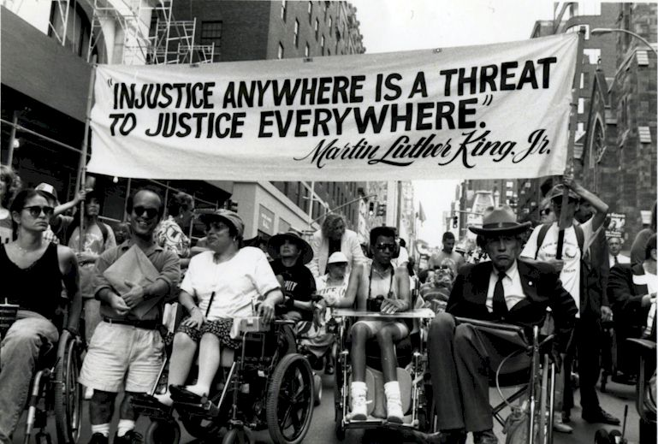
Accessibility is….
A civil (human) right of disabled people

Slide 9
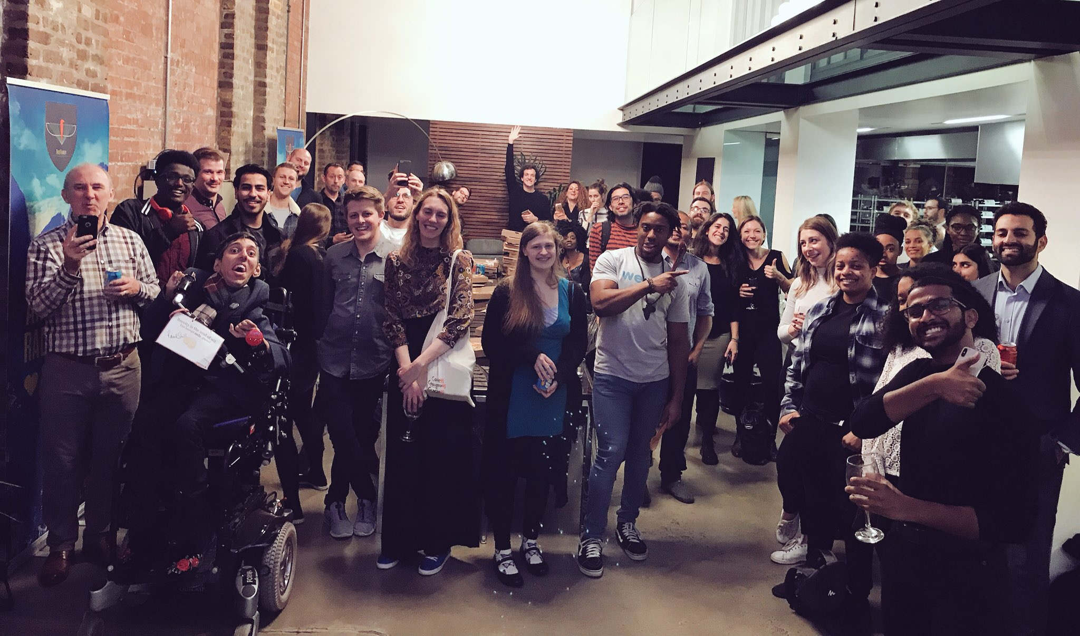
Essential for Some; Useful for All
photo: Carl Martin,
morethanwe.com

Slide 10
Why?

Slide 11

With Accessibility. . . .
Participation
Inclusion
Equality

Slide 12

No accessibility?
Left out
Exclusion
Discrimination

Slide 13
Judges Agree….
Today, internet technology enables individuals to participate actively in their community and engage in commerce from the comfort and convenience of their home. It would be a cruel irony …
to adopt the interpretation of the ADA espoused by Blick, which would render the legislation intended to emancipate the disabled from the bonds of isolation and segregation obsolete when its objective is increasingly within reach.. – J. Weinstein, federal judge

Slide 14
A11y is Right to information
Education
Transit
Voting
Services
Finance
Healthcare
Retail
Employment
Community
Sports

Slide 15

Accessibility is also…..
Confidentiality
Security
Privacy

Slide 16
Why be afraid of that?

Slide 17
Legal Equation for Access
Foundation (Laws and Regulations)
+
Advocates (Who)
+
Strategies (How)
Greater Accessibility

Slide 18
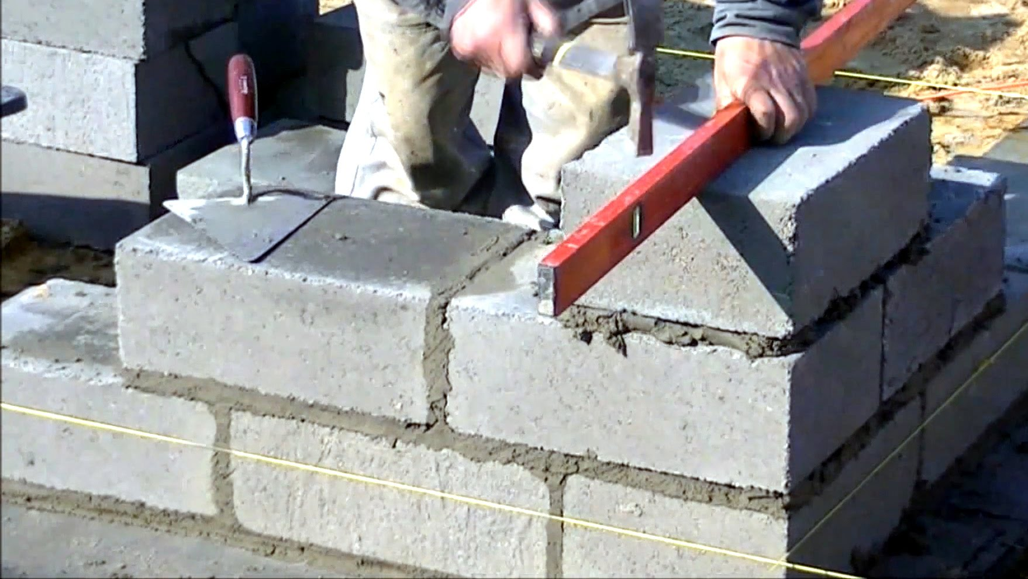
Foundation (it’s strong!)

Slide 19
US Laws and Policies
ADA
Public Sector
Private Sector
Employment
Federally funded (504)
Federal employment (501 and 503)
Federal Procurement (508)
Airline disability law
CVAA

Slide 20
ADA Web Regulations?

Slide 21
ADA Web Regs are Inactive
The ADA Isn’t!

Slide 22
Web Regs are Dead
ADA is Alive + Well

Slide 23

Judges agree….
“DOJ’s rulemaking process has no impact on the fitness of this case for adjudication”
Judge in 1-800-Flowers

Slide 24
Judges agree….
“The court will not delay in adjudicating [plaintiff’s] claim on the off-chance the DOJ promptly issues regulations it has contemplated issuing for seven years but has yet to make significant progress on.”

Slide 25
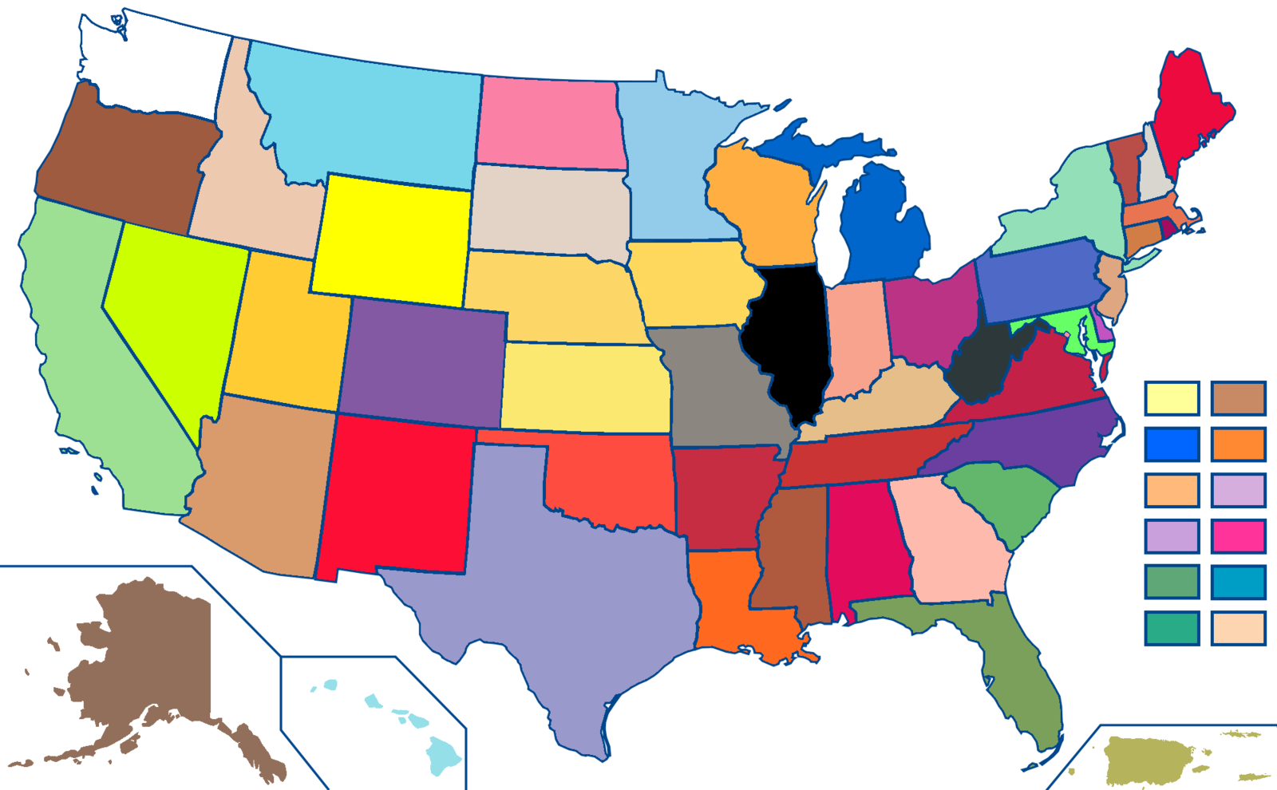
U.S. State Laws
State funded IT
State procured IT
State anti-discrimination laws
Local

Slide 26
Foundation Beyond the US
You are part of a global movement
UNCRPD
W3C WAI site w3.org/WAI/Policy/
LFLegal website – search “Japan”

Slide 27
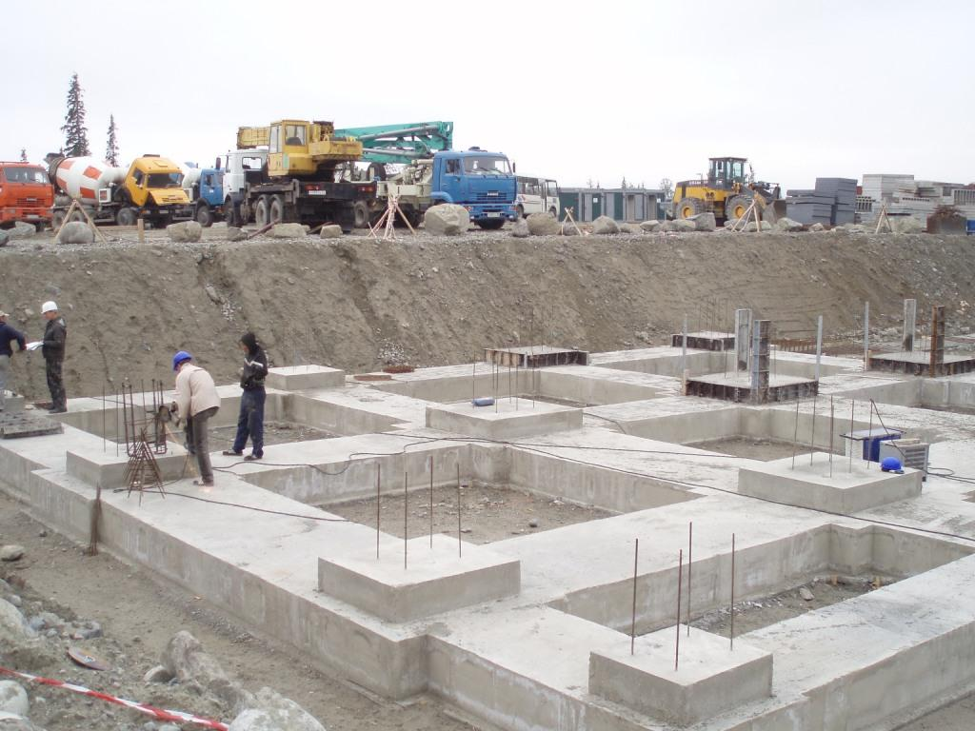
Without Advocates and Strategies….

Slide 28
Strategies for Enforcement

Slide 29

US Legal Strategies
Lawsuits
Federal Agency Complaints
Structured Negotiation

Slide 30
Strategy #1 Lawsuits Enforce Civil Rights

Slide 31



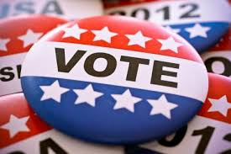

Lawsuits - Foundational
……..AN…

Slide 32
Lawsuits: (some) Recent Developments
BarBri settles
Orgs can sue (LACC)
Miami Consent Decree

Slide 33

Court Orders - Recent
Winn-Dixie (appealed)
Hobby-Lobby
Blick Art Materials
Blue Apron
1-800 - Flowers
Dominos (appealed)
Pizza Hut

Slide 34

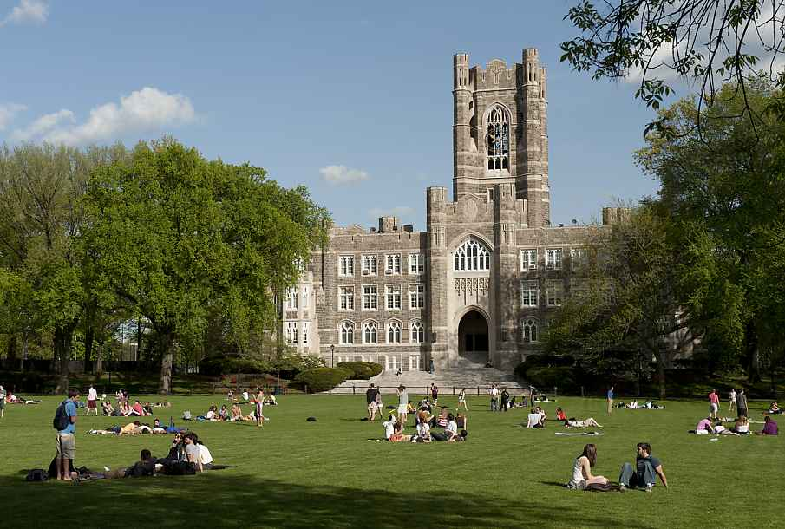
And more

Slide 36
Unusual Twists
Whistleblower case (TFA)
Web developer sued in Wet Willies
”Web Site Designed and Hosted by Sabre Technologies”

Slide 37

Big Picture #1
Some Courts: Need connection to physical place
Other Courts: No you don’t
Psst… websites are global!

Slide 38
Judges agree
“A rigid adherence to a physical nexus requirement leaves potholes of discrimination in what would otherwise be a smooth road to integration.”

Slide 39
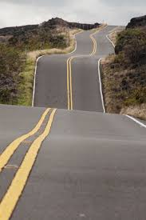
Big Picture #2
Don’t be distracted by court losses
Legal road leads to access (11/13)

Slide 40
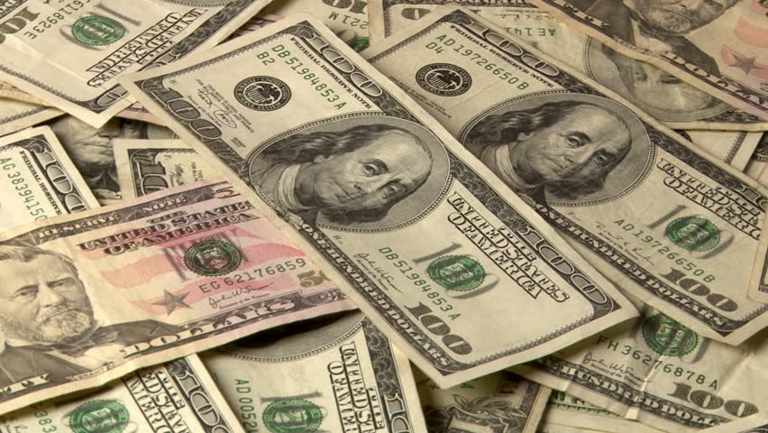
Spend Money on Access – Not on Lawyers

Slide 41
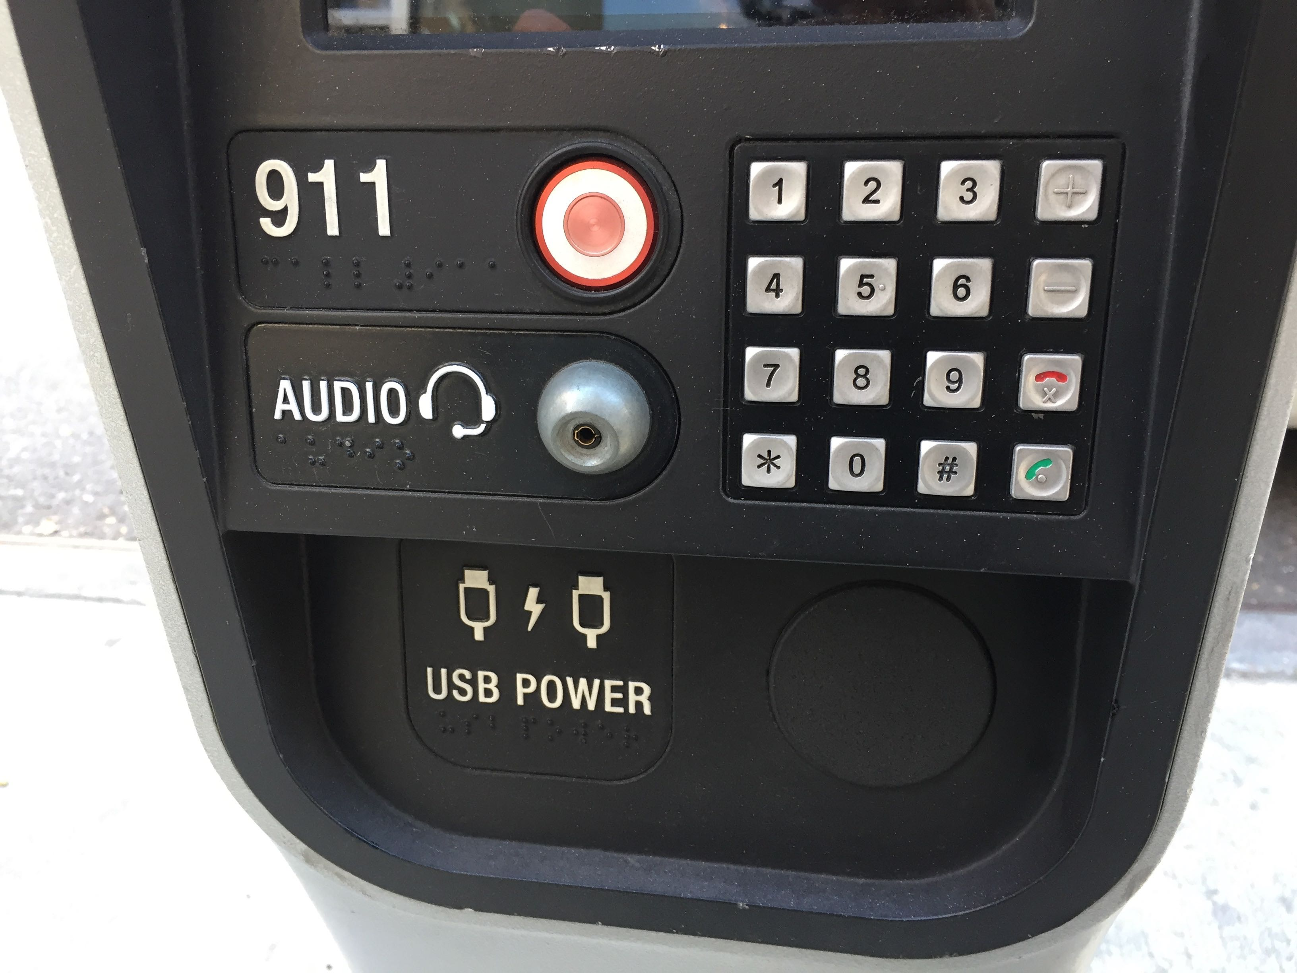
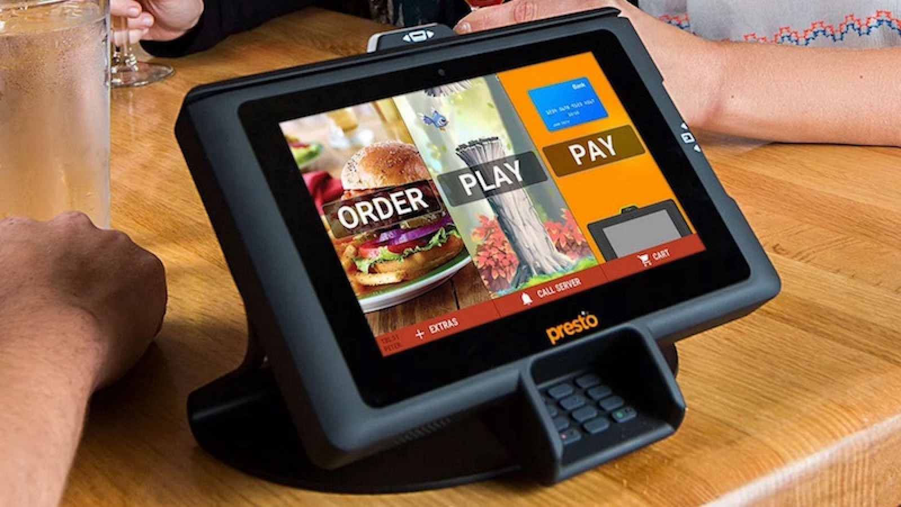
Digital Access > Websites
lflegal.com/2018/01/kiosks18/

Slide 42
Strategy #2

Slide 43
Gov’t Agency Activity
DOJ
State Atty Generals
DOE
DOT
FCC
Thursday @3:20 @CSUN w/ Karen Peltz-Strauss
Ada.goy

Slide 44
DOJ
2018
2004-2017

Slide 45
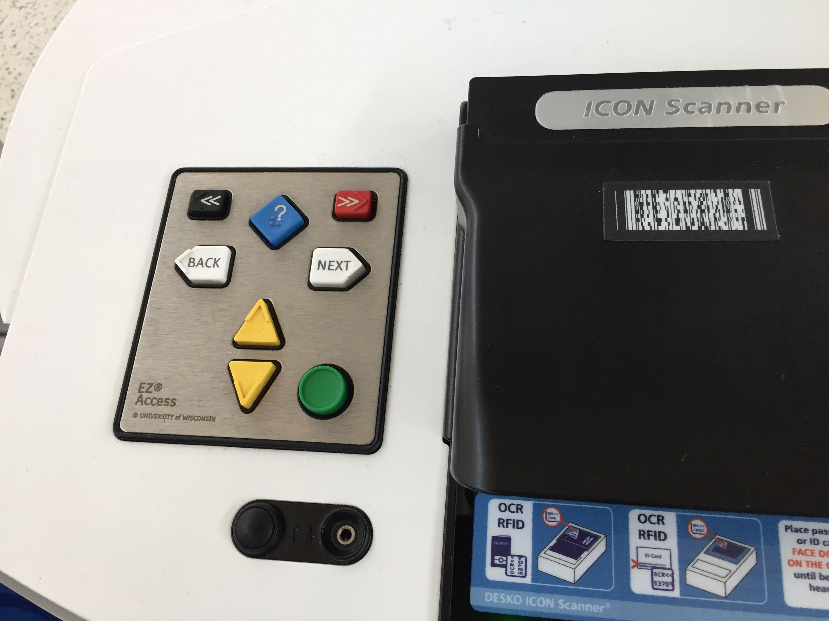
DOT Settlements with Airlines re Web And Kiosk

Slide 46

Dept of Ed: 2400 and counting [up or down??]…
Web Access
K-12 and Higher Ed
State /Local Departments of Education

Slide 47
Strategy #3

Slide 48





Structured Negotiation: Foundational

Slide 49




More Structured Negotiation Win-Wins /

Slide 50
Laws (foundation) +Advocates + Strategies Results

Slide 51

Threat to ALL Legal Strategies: HR 620

Slide 52

Good Strategies Make Access Stick

Slide 53
Best Practices….
Web and Mobile ++
WCAG 2.0 AA
Web Accessibility Coordinator- where?
Independent consultant – who?
Accessibility Policy

Slide 54

Best Practices…. Training
Who
What
By Whom
Check it out….

Slide 55
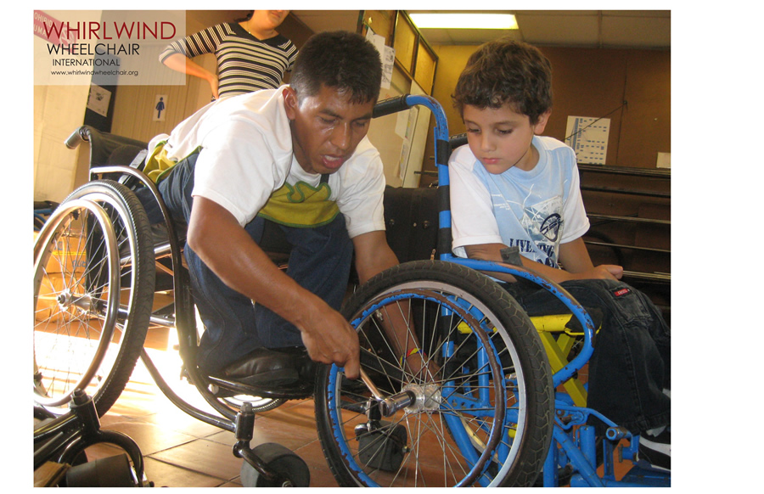
Best Practices…. Homepage AIP
LFLegal.com [search Hitachi]
Contact Information
Commitment
Photo: Whirlwind Int’l

Slide 56
Best Practices…. More
Add to performance evaluations
Use a testing tool
Usability Testing
Vendor Contracts (specificity)!

Slide 57
Best Practices….Culture!
Thursday at 10:00 ”Beyond Compliance” w/Microsoft’s Sue Boyd in Seaport Ballroom H (Microsoft Suite)

Slide 58
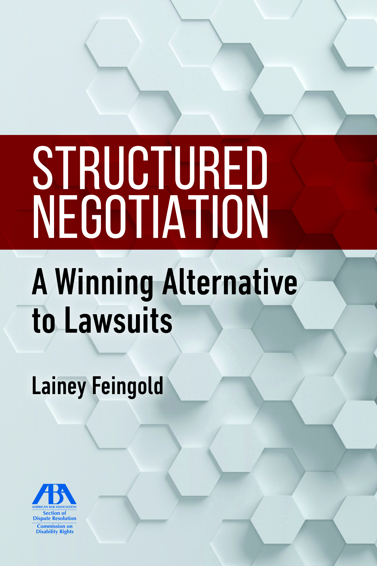
LFLegal.com/book
Stories!
Strategies!
A11y!

Slide 59
2018 CSUN Legal Update Repeats
Today at 2:20 in Seaport Ballroom A (Level Access suite) 2nd Floor Seaport Tower
Thursday at 3:20 in Seaport Ballroom B (VFO suite) 2nd Floor Seaport Tower . . . . . . . . and
Thursday at 10:00 ”Beyond Compliance” w/Microsoft’s Sue Boyd in Seaport Ballroom H (Microsoft Suite)

Slide 60
Want more law?
Higher Ed Updates: http://bit.ly/HigherEda11y
Lainey’s A11y Legal Updates: website + email
Seyfarth ADA Title III Blog:
Microassist Email list

Slide 61
Stay In Touch
@LFLegal
LFLegal.com/contact
LF@LFLegal.com
Website has: updates, settlements, media, webinars

